Slide 1
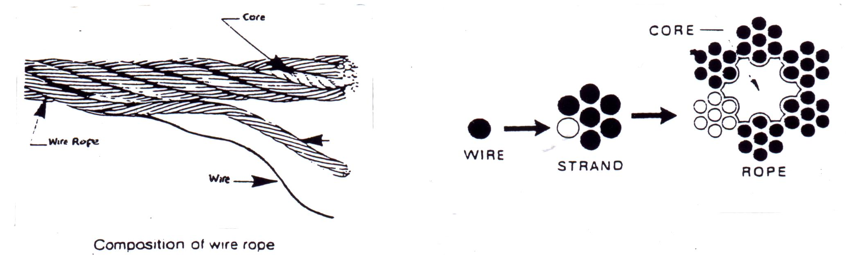
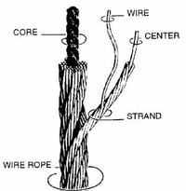
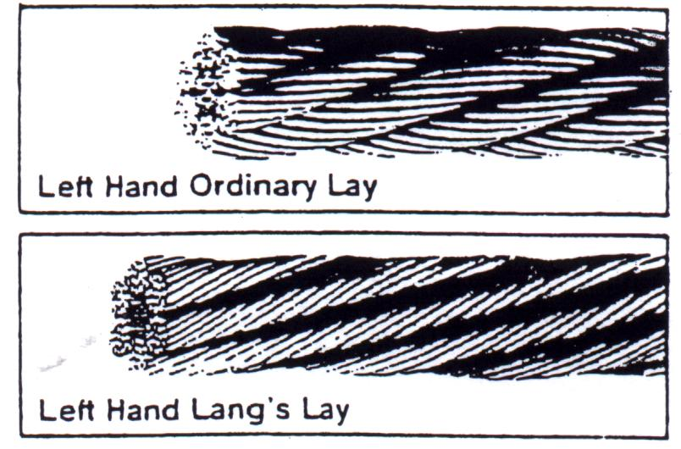

Steel wire rope

Slide 2
Chains
Inspection Criteria
Stretched links or deformation
Rust
Bent or deformed link
Peen Marks (Work Harding)
Safe Working Load Tag
Pitting
10% wear on any component
Identification markings
Chemical attack
Knots
Pin Wear (Hammerlocks)
Cracks
Heat exposure

Slide 3
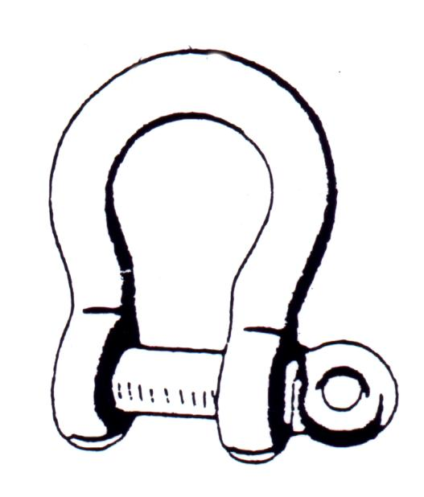
Shackles
Check for wear
Check for wear and straightness
Check that pin is always seated
Check that shackle is not ‘opening up’

Slide 4
Eye Bolts
Inspection Criteria
Capacity of eyebolt in regard to weight to be lifted
Markings (either imperial or metric)
Thread of eyebolt
Eye and body of eyebolt
Collar
Cracks/Fatigue
Nicks/Gouges
Rust - in countersunk hole

