Slide 1

Duties of officers, workers and other persons
Division 4 WHS Act outlines the duties of these persons
A person may have more than 1 duty at the same time
21 January 2020
1

Slide 2
Duties of officers
An ‘officer’ of a company is ‘a person who makes or participates in making decisions that affect the whole or a substantial part of the business or undertaking’
An Officer has a positive duty to exercise due diligence in ensuring the organisation complies with the law
21 January 2020
2

Slide 3
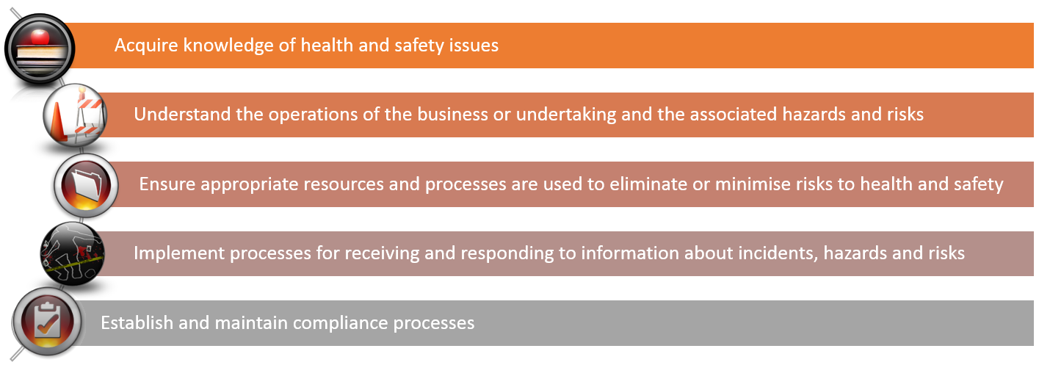
Due Diligence
21 January 2020
3

Slide 4
Duties of workers
take reasonable care for their own health and safety and electrical safety
take reasonable care that their conduct, acts or omissions does not adversely affect the health and safety of others or property
comply, so far as they are reasonably able with instructions
co-operate with reasonable WH&S policies or procedures that have been notified to workers
21 January 2020
4

