Slide 1

Work on a solid construction
‘Solid construction’ means an area that:
is structurally capable of supporting workers, and any loads applied to it
is provided with barriers around its perimeter and around any openings
has an even, accessible surface and gradient
has a safe means of entry and exit

Slide 2
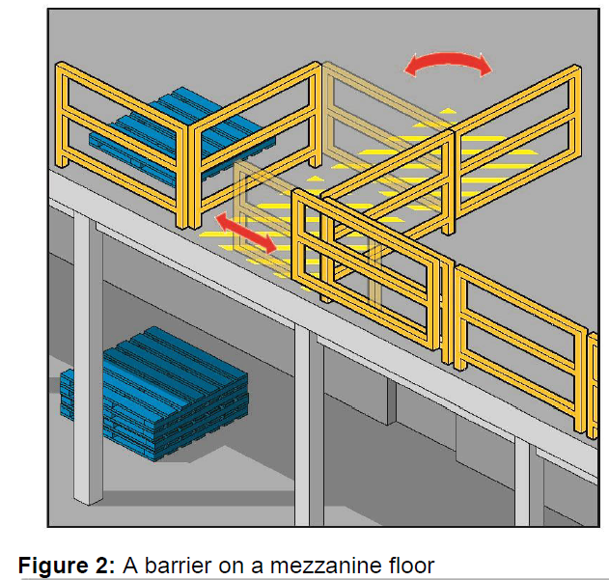
Edge protection
Edge protection to prevent a person falling over edges and into holes should be provided.
These include:
the perimeters of structures
mezzanine floors
openings in floors
the open edge of a landing, platform or shaft opening

Slide 3
Fall prevention
A fall prevention device is any equipment that is designed to prevent a fall for temporary work at heights, and once in place does not require any further adjustment by workers

