Slide 1
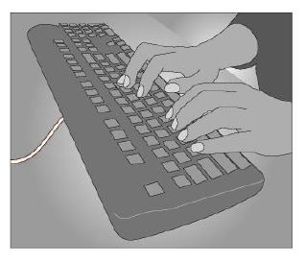

Work areas
The layout of work areas should be designed to provide sufficient clear space so that workers can move about freely
Notes:
The layout of work areas should be designed to provide sufficient clear space between furniture, fixtures and fittings so that workers can move about freely without strain or injury and also evacuate quickly in case of an emergency.

Slide 2
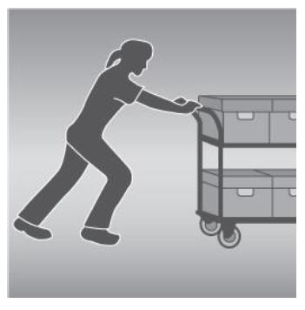
Floors and other surfaces
The choice of flooring will depend on
type of work carried out
materials used
likelihood of spills and other contaminants
Notes:
Floor surfaces should be suitable for the work area. The choice of floor surfaces or coverings will depend on the type of work carried out at the workplace, as well as the materials used during the work process, the likelihood of spills and other contaminants, including dust, and the need for cleaning.

Slide 3
Workstations
Workstations should be designed so that workers can carry out their work in a comfortable, upright position with shoulders relaxed and upper arms close to the body.

Slide 4
Lighting
Sufficient lighting must be provided to allow safe movement around the workplace and to allow workers to perform their job without having to strain their eyes to see.
Consider:
work activity
hazards and risks in the workplace
work environment
illumination levels
transition of natural light over the day
glare
contrast
reflections

Slide 5
Air quality
Workplaces should be adequately ventilated
Fresh air should be drawn from outside
Notes:
Workplaces should be adequately ventilated. Fresh, clean air should be drawn from outside the workplace, uncontaminated by discharge from flues or other outlets, and be circulated through the workplace.

Slide 6
Heat and cold
Thermal comfort
Hot environments
Cold environments

Slide 7
Access to facilities
Workers, including those who have particular needs or disabilities, must have access to the facilities.

