Slide 1
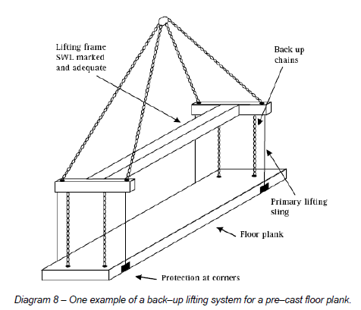

Lifting pre-cast elements over workers
Lifting of pre-cast panels over workers is permitted in limited situations
Other erection methods should be investigated prior to its acceptance

Slide 2
Operation of plant near braces and panels
The use of mobile plant close to panel braces can be hazardous due to the risk of the braces being struck and panels collapsing.
Braces that are struck by mobile plant are likely to collapse in a very rapid and uncontrolled fashion and there can be a very high risk of fatalities

Slide 3
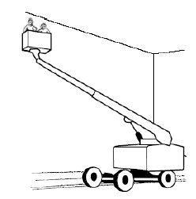
Working at height
Persons are required to work at height to perform the following:
attaching the panels to one another
structural steelwork
attachment and removal of braces to and from panels
application of caulking to the vertical joints between panels
patching work

Slide 4
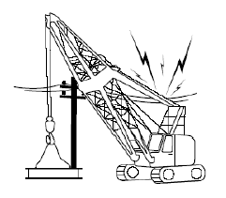
Proximity to overhead power lines
Contact with overhead powerlines can pose a major risk on tilt-up sites
Use of mobile cranes and
Other plant
Work at a height

