Slide 1
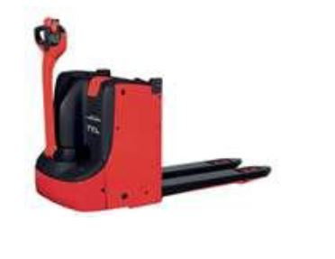

Pedestrian Operated Forklifts
Pedestrian operated forklifts (POFs) differ from forklift trucks because they are not intended to be controlled by an operator riding on the vehicle. While similar safe operating and maintenance procedures apply to all types of forklifts.
  A licence/certificate is not
  required to operate POFs

