Slide 1
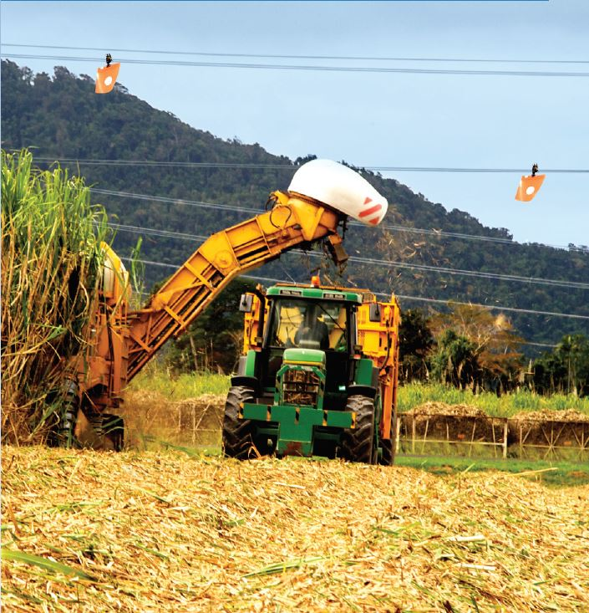

Outdoor work
Outdoor workers should have access to shelter for eating meals and taking breaks, and to protect them in adverse weather conditions.

Slide 2
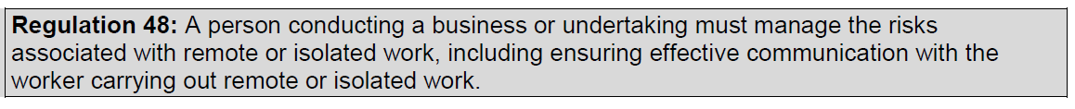
Remote or isolated work
Remote or isolated work is work that is isolated from the assistance of other people because of the location, time or nature of the work being done.
Assistance from other people includes rescue, medical assistance and emergency services.

