Slide 1
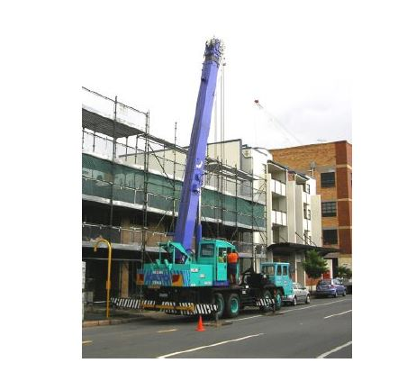

Maintenance, Inspection and repair
Inspection
Major Inspection
Worn or serviceable parts
Log maintenance

