Slide 1


Maintaining the work environment and facilities
The work environment should be maintained so that it remains in a clean and safe condition.

Slide 2
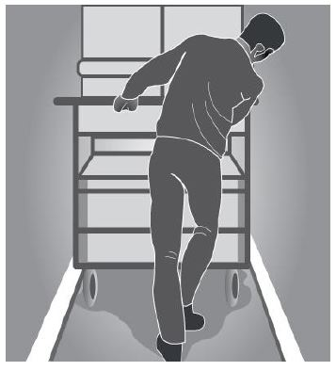
Entry and exit
The means of entry and exit to and from the workplace must be safe. This may include ensuring that workers with special needs or disabilities can safely enter and leave the workplace.

Slide 3
Housekeeping
An untidy workplace can cause injuries in particular, injuries resulting from slips and trips
spills on floors should be cleaned up immediately
walkways should be kept clear of obstructions
work materials should be neatly stored
any waste should be regularly removed.

