Slide 1
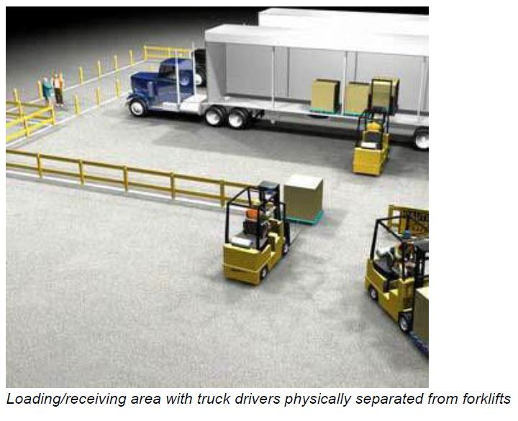

Loading and Unloading
Pallets
Steel racking
Adjustable pallet racking

