Slide 1

Inspection Requirements
A record of all tests, inspections, maintenance, commissioning, decommissioning, dismantling and alterations of plant for the period that the plant is used or until the person relinquishes control of the plant.
The maintenance, inspection and testing must be carried out:
in accordance with the manufacturer's recommendations
in accordance with the recommendations of a competent person
in relation to inspection, if it is not reasonably practicable to comply with paragraph (a) or (b), annually

Slide 2
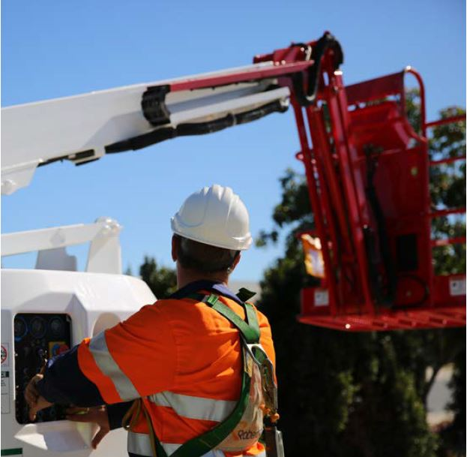
Additional Requirements
Amusement devices
Registered mobile cranes and tower cranes
Applications

