Slide 1
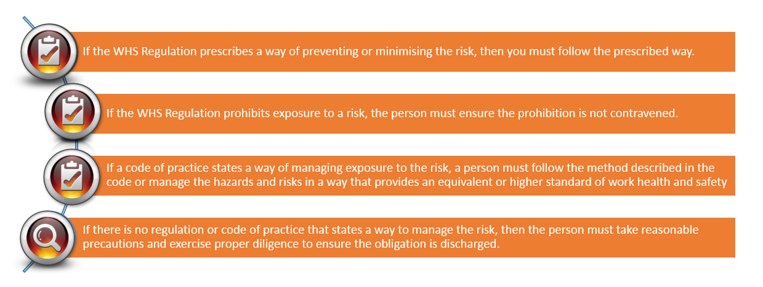

How to meet your WHS obligations
21 January 2020
1

Slide 2

How to meet your WHS obligations
21 January 2020
2

