Slide 1

HISTORY OF WHS LEGISLATION IN AUSTRALIA
Robens review
Traditional approach pre Robens Report:
adapt worker behaviour to the workplace and have the responsibility for safety
of employees.
Modern approach post Robens report:
focus on safe place rather than safe worker.
Union and employer group involvement
How have these groups contributed?

Slide 2
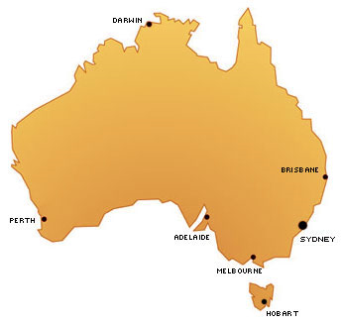
MODEL WHS ACT - OBJECTIVE
The main objective of the WHS Act 2011 is:
‘to provide for a balanced and nationally consistent framework to secure the health safety and welfare of workers and workplaces’.
Notes:
Harmonisation of WHS legislation has been introduced ‘to provide for a balanced and nationally consistent framework to secure the health safety and welfare of workers and workplaces’ (which is the main object of the WHS Act)
Discuss participants the need for the harmonisation process and a consistent approach (both in terms of continuous improvement , higher standards in work health and safety and changes in business organisation and activity).
Discuss how having different WHS law across states, territories and the commonwealth means there are inconsistencies which can cause confusion (e.g. definitions such as those for confined spaces) and impede outcomes of risk management.

