Slide 1

Hazards
including the risks of:
plant overturning
things falling on the operator of the plant
operator being ejected from the plant
plant collision
mechanical or other failures
Coming in contact with other persons

Slide 2
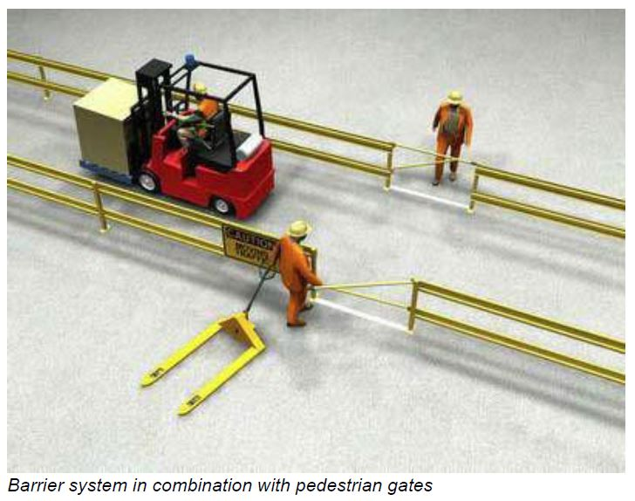
Specific hazards
Confined Spaces
Overhead Electrical Powerlines
Flammable atmospheres
Handling flammable materials
Hazardous areas
Working around forklifts

