Slide 1
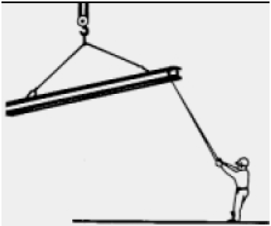

Hazards
These include:
Falling objects
Falls from heights
Collapse of structure
Collapse of cranes

