Slide 1
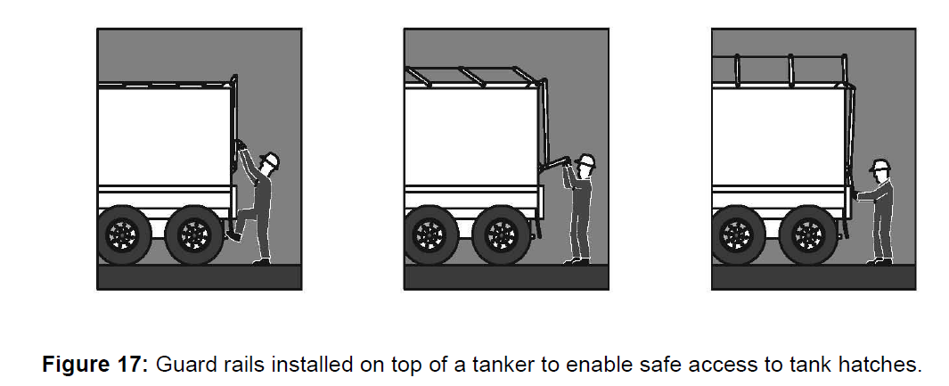

Perimeter guard rails
Guard rails may be used to provide effective fall prevention:
at the edges of roofs
at the edges of mezzanine floors, walkways, stairways, ramps and landings
on top of plant and structures where access is required around openings in floor and roof structures
at the edges of shafts, pits and other excavations
Guard rails should incorporate a top rail 900mm to 1100 mm above the working surface and a mid-rail and a toe board

Slide 2
Safety mesh
Safety mesh is designed to prevent falls through a roof. If securely fixed, safety mesh provides fall protection
Safety mesh does not prevent falls from the edge of a roof or through holes, so it should always be used in conjunction with edge protection or fall-arrest systems

Slide 3
Catch platforms
The use of control measures to “catch” a person after the person has fallen should only be used where it is not possible to provide any other more reliable means of fall protection

Slide 4
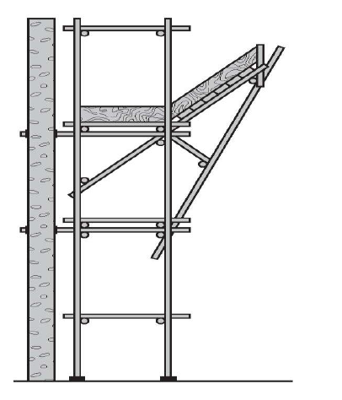
Catch platforms
A catch platform is a temporary platform located below a work area to catch a worker in the event of a fall
The platform should be
Of robust construction
designed to withstand the maximum impact load
Scaffolding components may be used to construct catch platforms
Figure 20: An example of a catch platform below a work area.

Slide 5
Industrial safety nets
Safety nets can provide a satisfactory means of protection while allowing workers maximum freedom of movement
They should not be used to enter or exit a work area or as a working platform

Slide 6
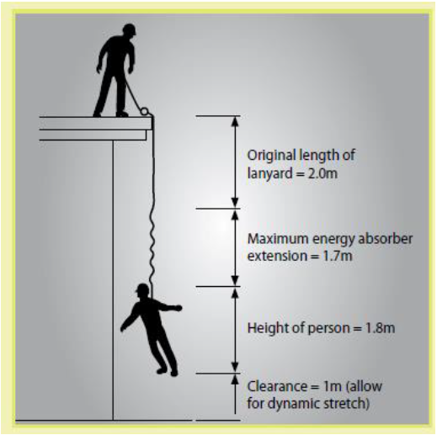
Industrial fall-arrest systems
May consist of the following:
anchorages
inertia reel
lanyard of fixed length
retractable lifelines
rope grabs
wire grabs
rail system
shock absorbers
snap hooks
karabiners
rescue equipment

Slide 7
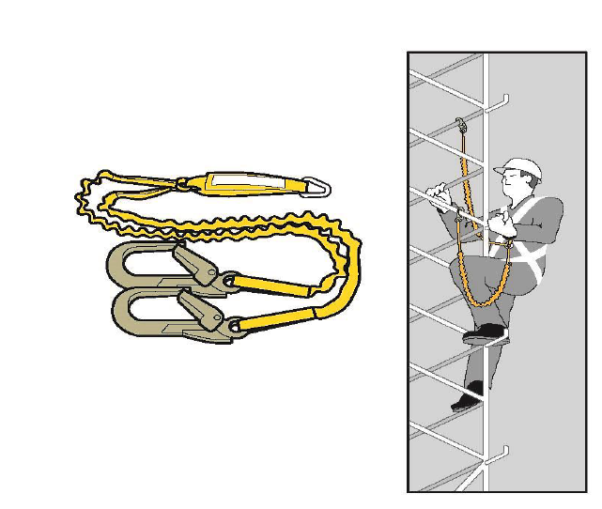
Anchorage lines or rails
Anchorage lines or rails are fall-arrest systems, which can be installed to provide continuous fall protection for persons using ladders or climbing towers
Notes:
Anchorage lines or rails are fall-arrest systems, which can be installed to provide continuous fall protection for persons using ladders or climbing towers.
These can be used on plant, such as tower cranes, as well as buildings or structures.

