Slide 1

Drinking Water
An adequate supply of clean drinking water must be provided.
The supply of the drinking water should be:
can be easily accessed by workers
close to where hot or strenuous work is being undertaken
separate from toilet or washing facilities

Slide 2
Toilets
Access to clean toilets must be provided for all workers while they are at work.

Slide 3
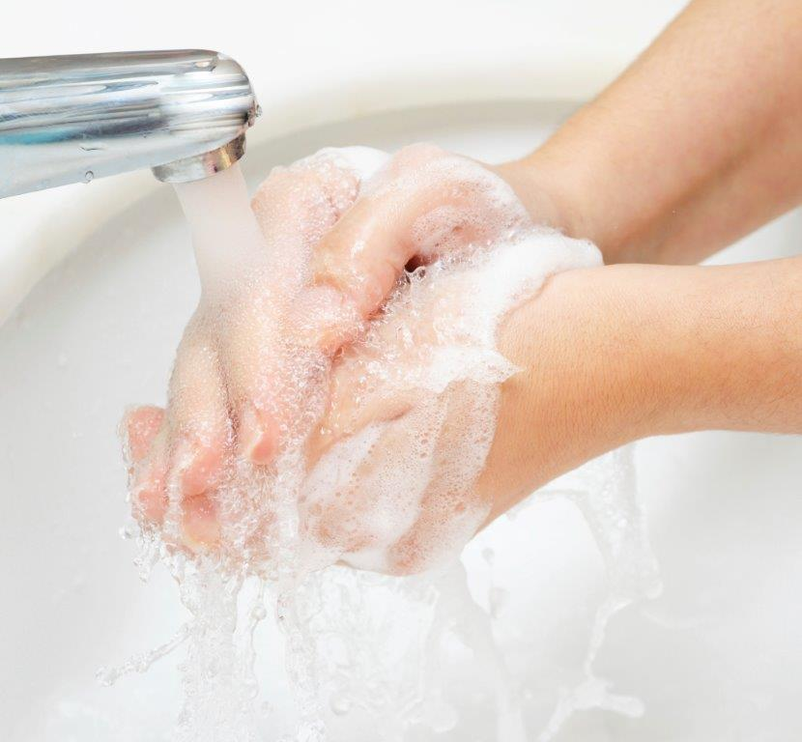
Washing Facilities
Showers
Hand Washing

Slide 4
Dining
Dining area should be provided
A separate dining room provided if:
10 or more workers usually eat at the workplace at the same time
there is a risk of substances or processes contaminating food.

Slide 5
Personal Storage
Accessible and secure storage should be provided at the workplace for personal items
Where any work involves the use of tools provided by a worker, provision should be made for secure and weatherproof storage of those tools

Slide 6
Change Rooms
A change room should be provided if workers must change in and out of clothing due to the nature of their work.
This includes workers who need to:
Wear protective clothing or uniforms at work
Leave their work clothing at the workplace

