Slide 1
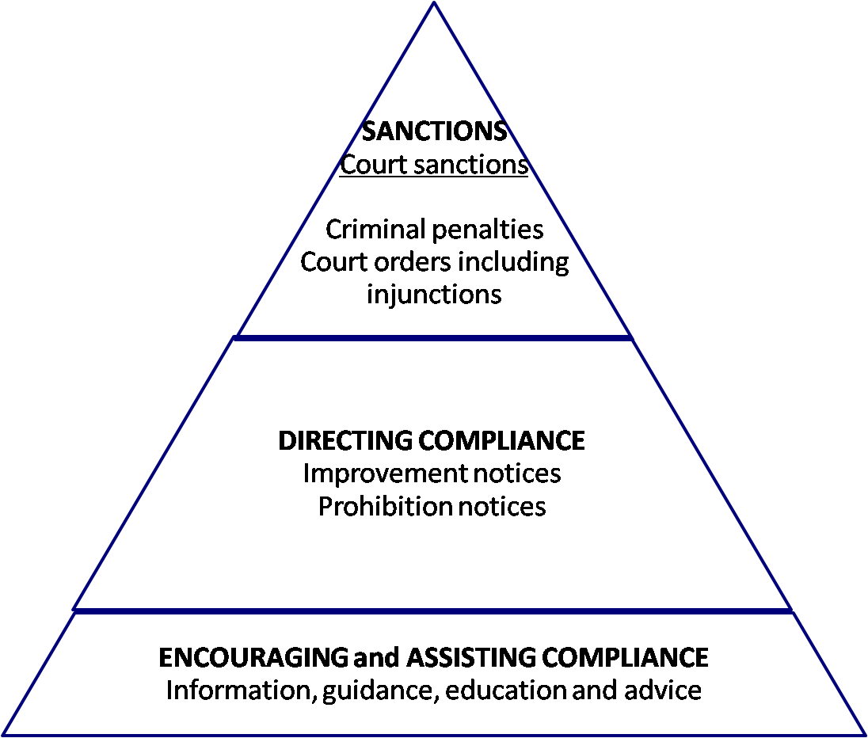

ESCALATING APPROACH OF REGULATORS
16 January 2020
1
Notes:
The pyramid diagram represents the escalating approach that regulators may adopt in relation to a work health and safety issue.
The lowest level of the pyramid involves an approach which is employed most frequently by regulators.
Sanctions are at the top of the pyramid and are applied less frequently.
This does not mean that regulators will always commence with provision of information and advice, and only use other tools in an escalated manner.
Regulators will use the tools that are most appropriate in the particular circumstances.
Using a range of tools in the lower levels of the pyramid may often achieve compliance without needing to escalate to the more serious levels of sanctions.
Enforcement measures:
Improvement Notices
Prohibition Notices
Non-disturbance notices
Enforceable (WHS) undertakings
Potential outcomes of legal proceedings:
Adverse publicity orders
Orders for Restoration
Work Health and Safety (WHS) project orders
Court ordered WHS undertakings
Injunctions
Training Order

