Slide 1
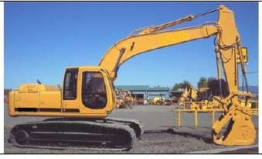

Earthmoving equipment
Competency based training and VOC assessment for these occupations

