Slide 1
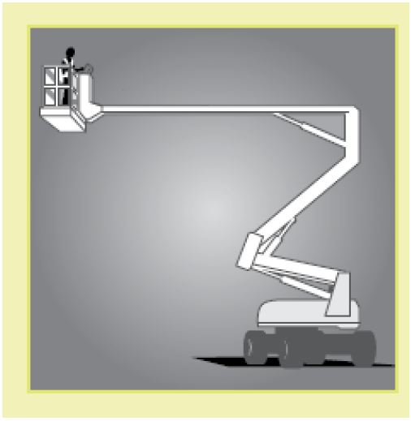
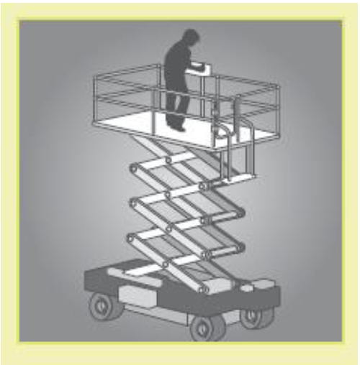
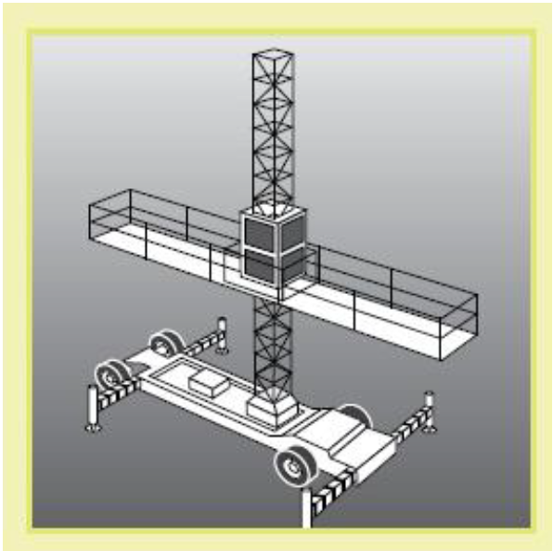

Elevating work platforms
Elevating Work Platforms (EWPs) include scissor lifts, cherry pickers, boom lifts and travel towers

Slide 2
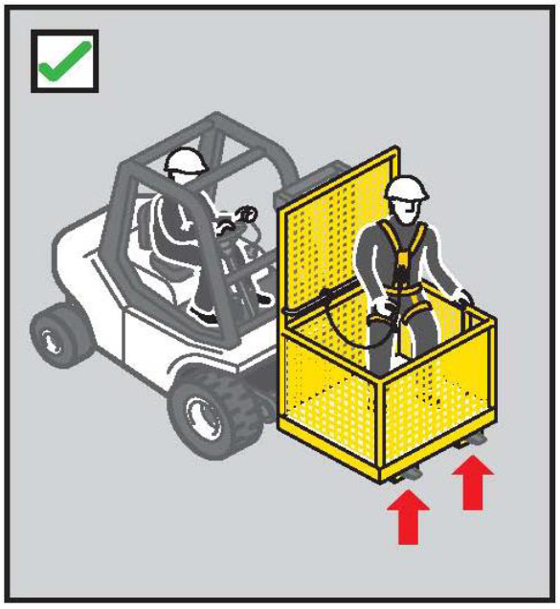
Workbox
A workbox is designed to be supported by a crane, hoist, forklift truck to provide an elevated work area for persons working from the box
Where reasonably practicable, an elevating working platform or scaffold, should be used as an alternative to the workbox

Slide 3
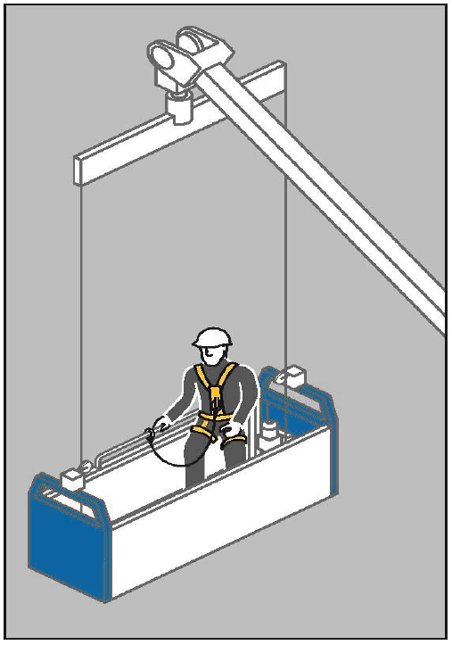
Building maintenance units
A building maintenance unit is a power-operated suspended working platform that is fixed permanently to a building or structure

Slide 4
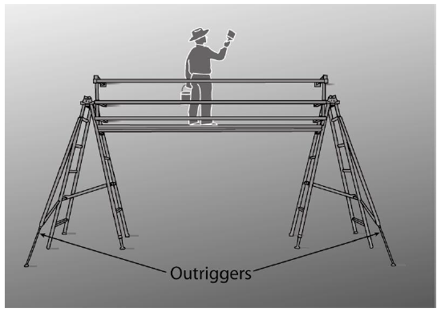
Platforms supported by trestle ladders
Trestle ladder scaffolds are only suitable for use at heights greater than two metres when guard rails and toe boards are incorporated to prevent people and material falling off

