Slide 1
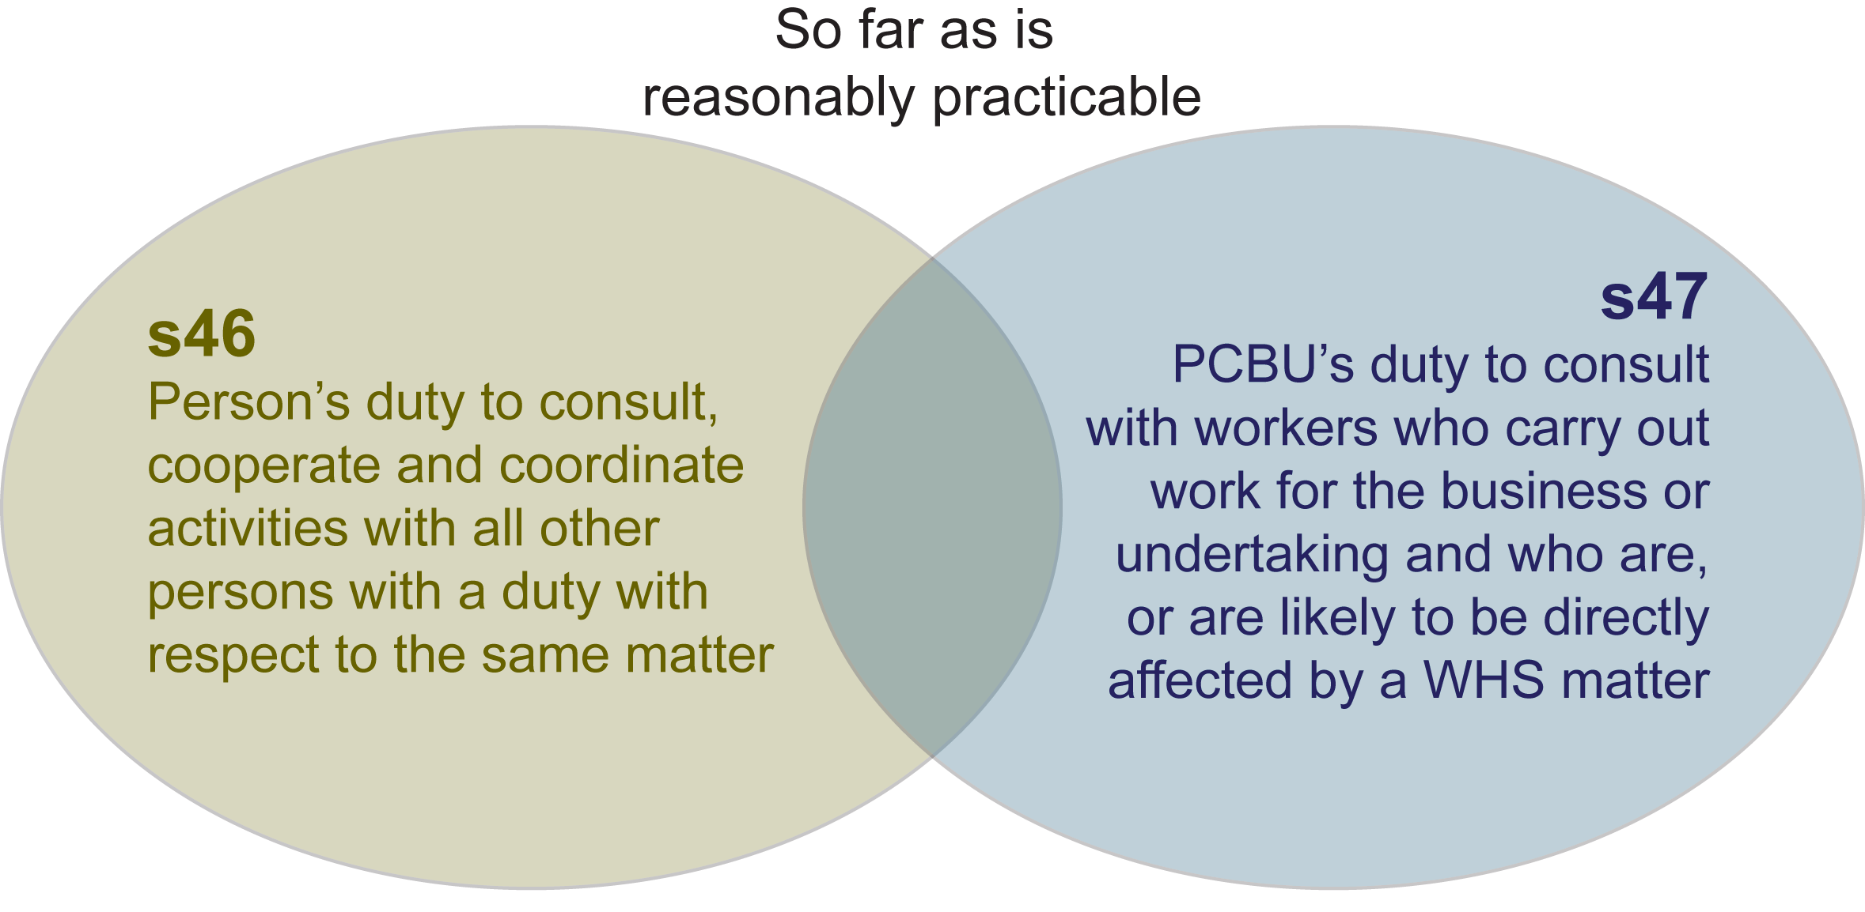

DUTY TO CONSULT WITH WORKERS AND OTHERS
Notes:
Each PCBU is required to consult with their workers and each other in matters affecting work standards, rules and procedures that affects the health and safety of workers.
Also, it may not be reasonably practicable to consult with workers who are on extended leave. However, it would be appropriate to ensure that these workers are kept informed about any matters that may affect their health and safety when they return to work.
HSRs can be shared between PCBUs
Consultation involves sharing of relevant information
Cooperation and coordination could involve the planning and coordination of activities.
PCBUs are not expected to do the impossible, but are required to take a proactive and sensible approach to consultation.
Factors which will affect how consultation is undertaken could include:
nature of the decision or action, including the urgency to make a decision or take action;
availability of the relevant workers and any health and safety representatives;
work arrangements, such as shift work and remote work; and
characteristics of the workers, including languages spoken and literacy levels.

Slide 2
CONSULTATION BETWEEN DUTY HOLDERS
Duty holder
e.g. Site controller
Duty holder
e.g. Business owner
Duty holder
e.g. Labour hire company
Consultation procedures and arrangements
e.g. Emergency procedures, work arrangements
Consultation
e.g. sharing of information on potential hazards
Co-operation
e.g. management of interactions between workers
Co-ordination
e.g. planning and organising work activities
Notes:
This shows an example as to how consultation may occur between duty holders that are present or have workers present at a particular workplace.

Slide 3

ARRANGEMENTS FOR CONSULTATION
Options available as agreed between PCBUs and workers include:
Health and Safety Representatives (HSRs) to represent their workgroups with their role focused on resolving specific work health and safety issues
Health and Safety Committee (HSC) – the forum for consultation on the management of health and safety across the whole workforce.
Other arrangements e.g. direct consultation through regular team meetings.
WHS entry permit holders can assist in establishing consultation arrangements and consult with members/eligible members on health and safety issues.

