Slide 1
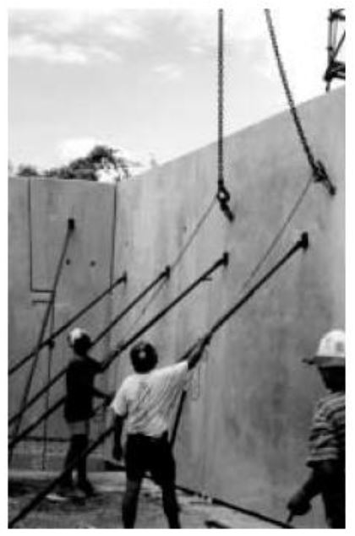

Duties
PCBU
Officers
Workers

