Slide 1

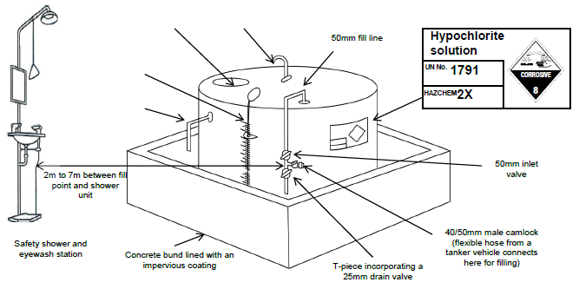

Containing spills

Slide 2

Emergency Plan

