Slide 1
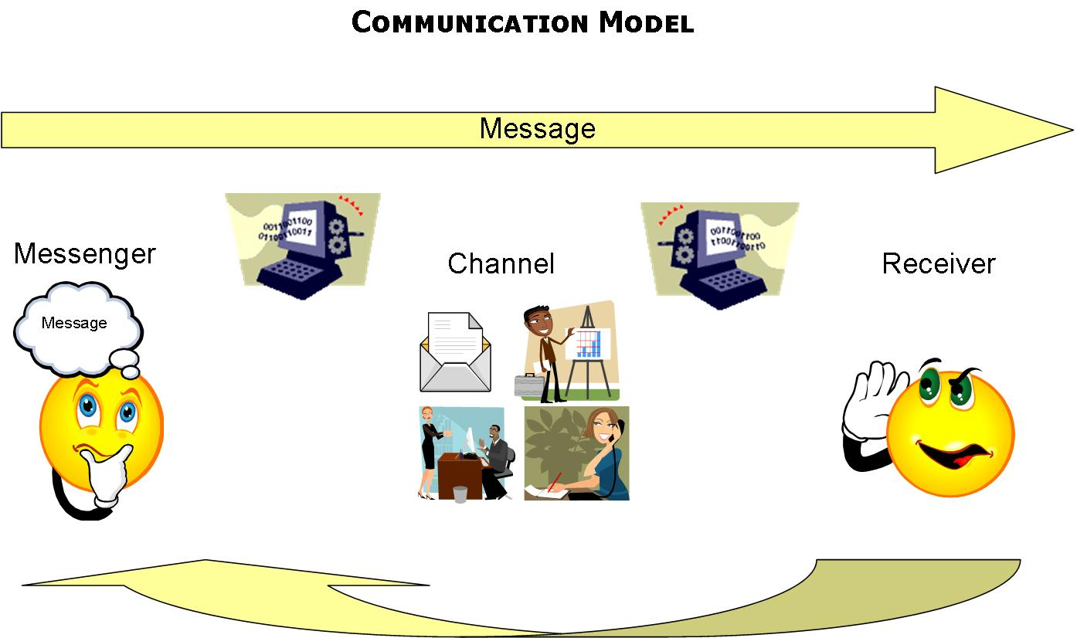

COMMUNICATION MODEL
Notes:
COMMUNICATION PROCESS
If there is no recipient, then communication cannot occur. i.e. if a class is not listening, then the teacher is not teaching.
It is a myth that the message you send is identical to that which is received. Every message sent must travel a path through the recipient’s sensory organs before being sifted and sorted by the brain.
When perceptual problems occur, it is inevitable that communication will break down. The effectiveness of the workplace is determined largely by its members’ communication skills. As a HSR that is dealing with identifying hazards, workplace inspections, helping implement safety controls, or negotiating for safer working conditions, the level of success will depend on the HSRs ability to communicate, and therefore their ability to identify different perceptions.
A skilful communication style is necessary to ‘convince’ the individuals within the workplace of the benefits of the HSRs position, or to inform and persuade the workgroup (or PCBU) of safety issues. A good deal of our communication style derives from our culture and upbringing. We live and work in a multicultural world and increasingly in our workplaces there are people with special needs. Therefore, we need to gain an understanding of individual needs and behaviours in order for us to communicate our safety issues/topics effectively.

Slide 2
EFFECTIVE COMMUNICATION
General principles for effective consultation include the following:
Two way flow
High self esteem
Defensiveness creates major barriers to communication
Understanding others
Physical environment
Part of communication is physical
Feelings are sometimes more important that fact
You cannot ‘win’ an argument

Slide 3
COMMUNICATION BARRIERS
Barriers to recognise and overcome in order to use effective communication as a tool for safety improvement include:
Language
Perceptions, prejudice and stereo-typing
Self-image
Status
Incongruity
Time and timing
Environmental factors
Listening
Message complexity
Individual factors and not understanding the need for special consideration

Slide 4
ENSURING EFFECTIVE REPRESENTATION
Information sharing processes in the workplace
Formal Forums
HSC and other meetings with management
Informal Forums
‘Water cooler’ discussions
talks with workgroup members
Individual factors and the need for special consideration

