Slide 1
Chemical security in small business
Chemical security for small business owners and managers

Slide 2

Registers
A register of hazardous chemicals at the workplace is prepared and kept up to date.
Register must be readily available to workers involved in using, handling or storing hazardous chemicals and to anyone else who is likely to be affected.

Slide 3
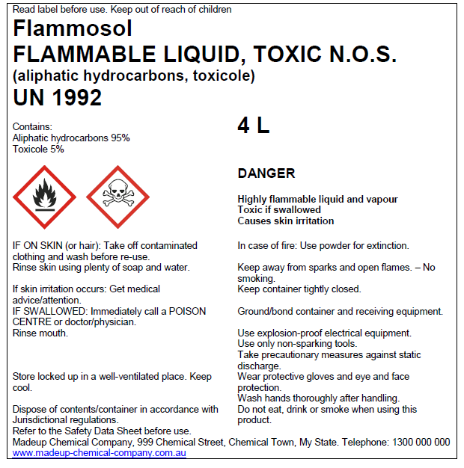
Labelling Containers
What is needed on a label?
Transport labelling versus workplace labelling requirements
Specific labelling situations
Unlabelled containers/unknown contents
Example GHS

Slide 4
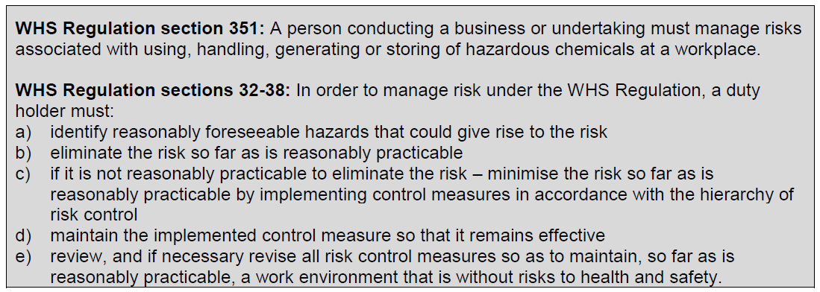
Risk management

Slide 5
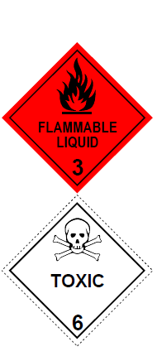
Safety Signs
Along with container labels and the provision of SDS, safety signs and placards contribute to the hazard communication system at a workplace.

Slide 6
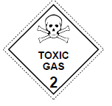

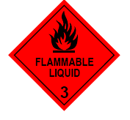
Placards
Are a safety sign that contains information about the hazardous chemical stored and are to be displayed in a prominent place, or next to a container or storage area.
Placards:
alert people to the presence of hazardous chemicals
identify hazardous chemicals stored in bulk
identify areas where significant quantities are stored
identify the hazards of goods present
indicate the required emergency actions
Notes:
Are a safety sign that contains information about the hazardous chemical stored and are to be displayed in a prominent place, or next to a container or storage area.
Placards:
alert people (workers, contractors, visitors and emergency service personnel) to the presence of hazardous chemicals
identify hazardous chemicals stored in bulk (e.g. tanks)
identify areas where significant quantities of hazardous chemicals in packages are stored
identify the hazards of goods present, and indicate the required emergency actions for hazardous chemicals in tanks through the use of the HAZCHEM code.

