Slide 1
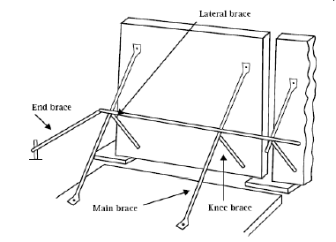

Braces
Concrete panels rely on the integrity of braces and their correct installation.
Bracing
Lateral brace
End brace
Main brace
Knee brace

