Slide 1
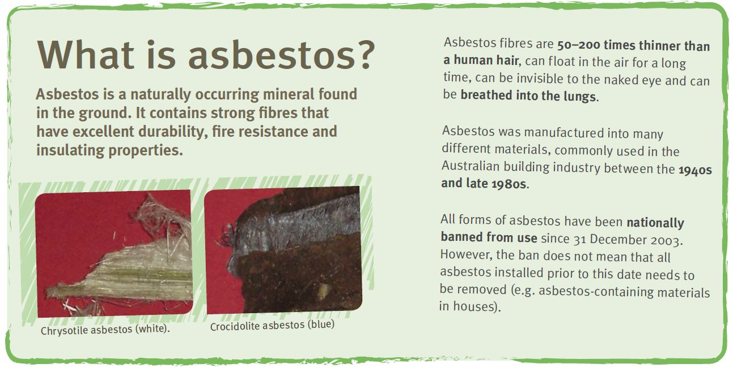

Asbestos Licence
There are two types of asbestos removal licences:
friable asbestos - class A
non-friable (bonded) asbestos - class B

Slide 2
Demolition Work
You must have a demolition work licence to demolish or dismantle a structure that:
contains pre-tensioned or post-tensioned structural components
involves use of load shifting equipment
involves the use of explosives
another induced collapse method

