Slide 1
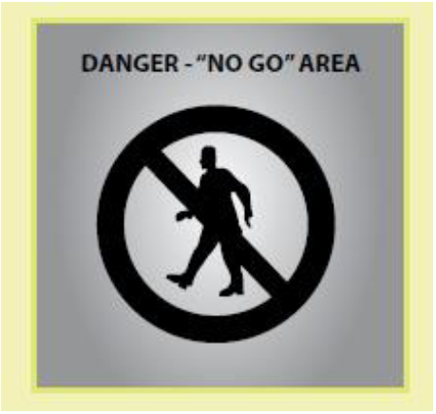

Administrative controls
Administrative controls may be used to support other control measures and may include ‘no go’ areas, permit systems, the sequencing of work and safe work procedures
Notes:
Administrative controls may be used to support other control measures and may include ‘no go’ areas, permit systems, the sequencing of work and safe work procedures. Using administrative controls exclusively to minimise the risk of falls is only appropriate when it is not reasonably practicable to use a higher order control.

