Slide 1

Hazardous Chemicals
HAZARDOUS CHEMICALS

Slide 2
Download reference documents
Supervisor
  Procedures
Workers
  SOP
  Risk assessment
  Forms

Slide 3
Legislation
WHS Act 2011
WHS Regulation 2011
Codes of Practice
Managing Risks of Hazardous Chemicals in the Workplace
Preparation of Safety Data Sheets for Hazardous Chemicals
Labelling of Workplace Hazardous Chemicals

Slide 4

What is a hazardous chemical?
A hazardous chemical is any substance or mixture that satisfies the criteria of one or more of the Globally Harmonised System of classification and labelling of chemicals (GHS) hazard classes, including a classification in Schedule 6 of the Regulation.

Slide 5
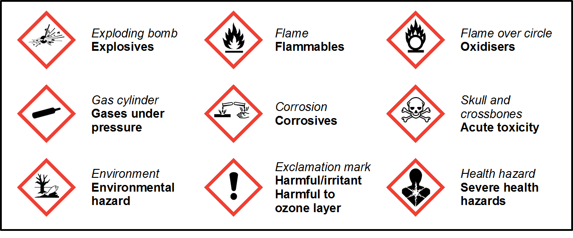
Globally harmonised system (GHS)

